Slide 1

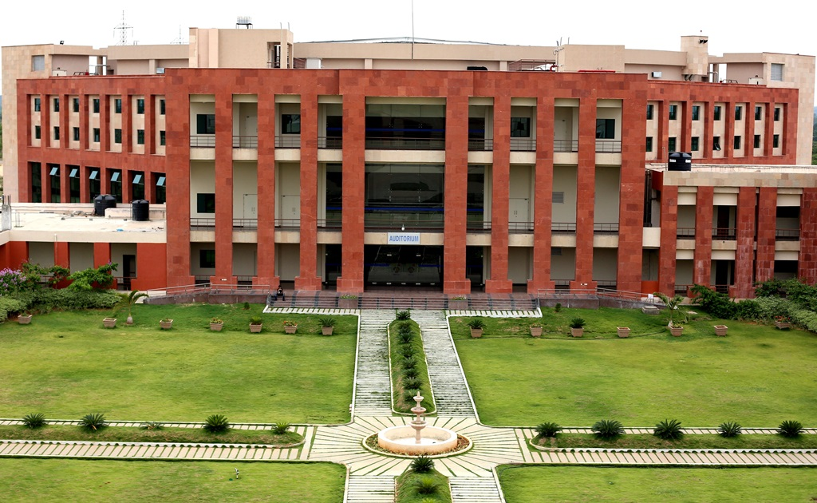
Principles of Programming Languages
(CS F301)
Jabez Christopher
Assistant Professor
Department of CSIS

Slide 2
Formal Methods of Describing Syntax
Regular Expression
BNF [Chap.3 - Sec. 3 in Text]
EBNF
Attribute grammar (Syntax & Semantics) [Ch. 3 - Sec. 4 in Text]
QUIZ 1 : Upto EBNF…. Section 4 not included
(10:00 AM 7-Oct,2022)

Slide 3
Denotational Semantics
Based on recursive function theory.
A mathematical object: denotes the meaning of their corresponding syntactic entities
A function: maps instances of that language entity onto instances of the mathematical object.
-- Domain: syntactic domain
-- Range: semantic domain

Slide 4
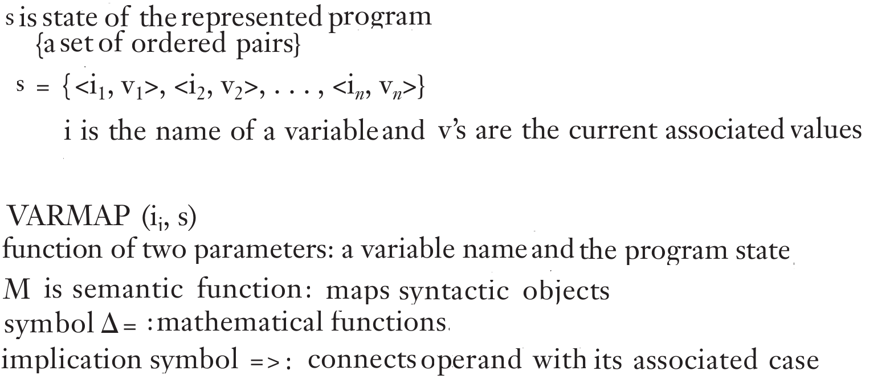
Denotational Semantics

Slide 5
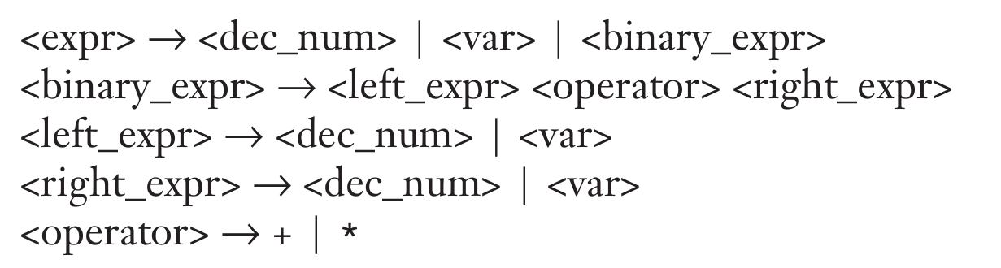
Denotational Semantics

Slide 6
Axiomatic Semantics
Based on mathematical logic
Precondition: An assertion that immediately precedes a program statement and describes the constraints on the program variables.
Postcondition: An assertion that follows a statement and describes the new constraints on those variables (and possibly others) after execution of the statement.
Weakest precondition: the least restrictive precondition that will guarantee the validity of the associated postcondition.

Slide 7
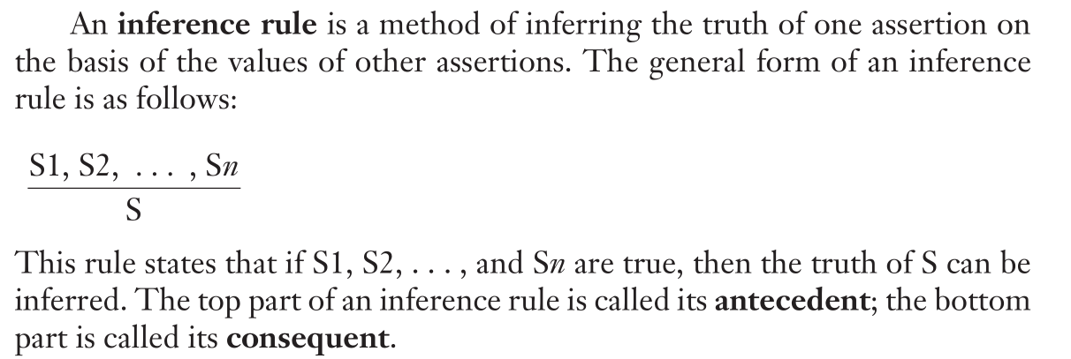
Axiomatic Semantics

Slide 8
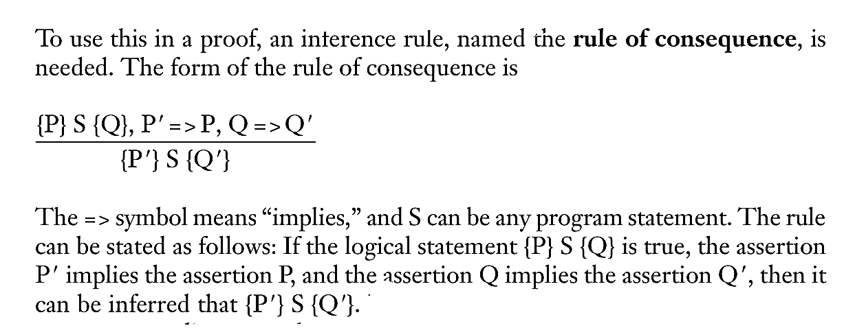
Axiomatic Semantics

